Slide 1
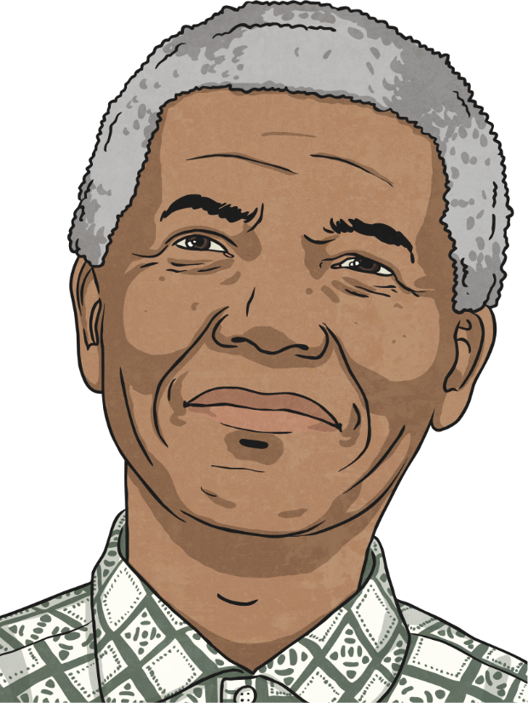
Long walk for freedom (Auto Biography) Author: Nelson Mandela
Name: Darshit Bhatt
Sem:7th
Roll no.:03
Subject: SSD 411
Guide By:
Prof.(Dr.)Y R Ghodasara
Professor, AIT department,
College of AIT, AAU, Anand

Slide 2
Nelson Mandela : A Long Walk To Freedom
This is the name of Mandela’s autobiographical book.
This occurs in South Africa and tells the story of Nelson Mandela, from his life as a young boy to his decades long stay in prison.
It discusses apartheid in South Africa and Mandela's struggle for equal human rights for everyone in his country.
Human rights – freedoms every person should have
Racial prejudice - treating people unfairly because of their race or skin colour.

Slide 3
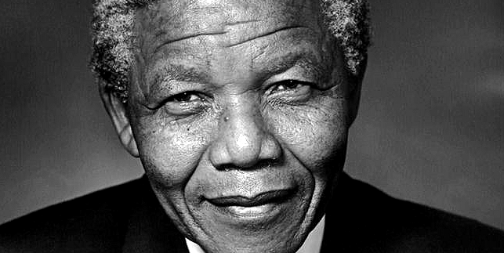
Nelson Mandela's early life is focused on, as he struggled for the equal treatment of black people in his country. The story does not focus on grim details, but it does make clear the struggles faced by so many.
As it is abridged from his autobiography, this chapter is in the first person and details events from Nelson Mandela's perspective.

Slide 4
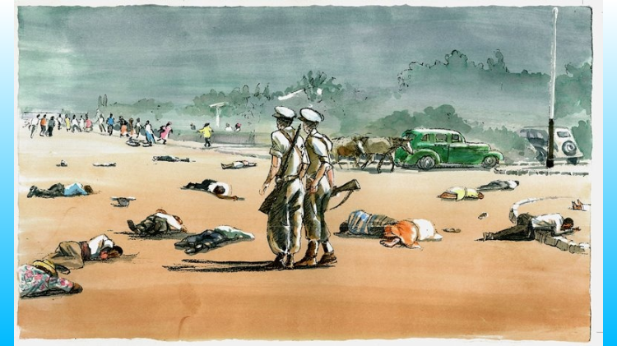
Apartheid in South Africa
Apartheid, which means separateness, was enforced in South Africa from 1948 until 1994, when the first vote including all South Africans was held. During apartheid, those inhabitants of South Africa who were not white had their rights restricted and were not allowed the same freedoms as their white counterparts.
Nelson Mandela, and many others, fought against this system, eventually overturning it and forever changing the face of South Africa's history.

Slide 5
Growing Up
Rolihlahla Mandela was born on 18 July 1918.
The name Nelson was a nickname given to Mandela by his school teacher.
He was born in Transkei in South Africa
He was a member of Thimbu royalty and his father was chief of the city of Mvezo.
He attended a Christian school and later went to college and university.
Mandela studied law at university and met some of his fellow activists against the apartheid whilst he was studying.
He became a lawyer in 1942.-

